Slide 1
DATA100
Principles of Data Science
Data Visualization Idioms

Slide 2

Join at slido.com
#just-somethink

Slide 3
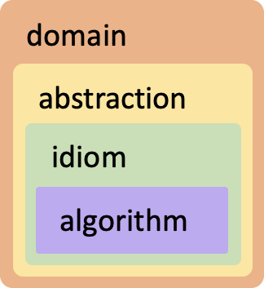
Four Levels of Visualization Design
Recall
What?
Why?
How?
[A Nested Model of Visualization Design and Validation. Munzner. IEEE TVCG 15(6):921-928, 2009
(Proc. InfoVis 2009). ]

Slide 4
Four Levels of Visualization Design
Recall
Domain
Who are the target users?
Abstraction
Translate from specifics of domain to vocabulary of visualization
What is shown? Data abstraction
Why is the user looking at it? Task abstraction
Idiom
How is it shown?
Visual encoding idiom: how to draw
Interaction idiom: how to manipulate
Algorithm
Efficient computation

Slide 5
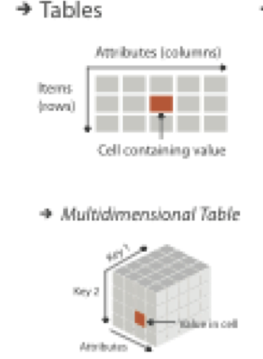
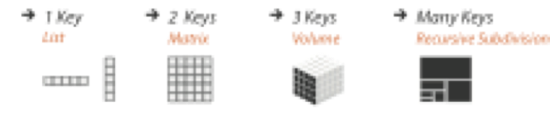
Keys and Values
KEY .
Independent attribute
Unique index to look up items
Simple tables: 1 key
Multidimensional tables: multiple keys
VALUE .
Dependent attribute
Value of cell

Slide 6

Common Visualization Idioms
Matching data with the representation

Slide 7
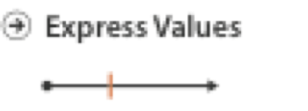
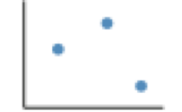
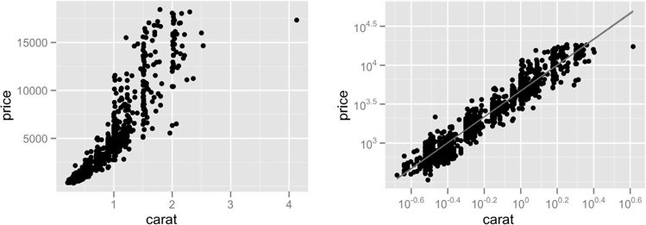
Scatterplot
Express values
Quantitative values
No keys, only values
Data: 2 quant attributes
Task
Find trends, outliers, distribution, correlation, clusters
[A layered grammar of graphics. Wickham. Journ. Computational and Graphical Statistics 19:1 (2010), 3–28.]

Slide 8
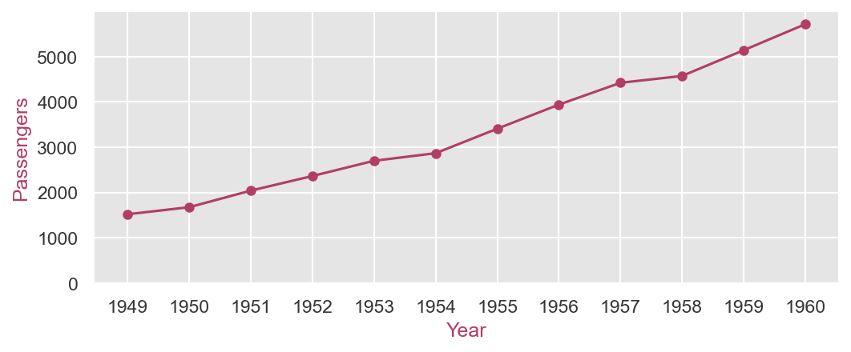
Line Chart / Dot Plot
One key, one value
Task
Find trend
Connection marks emphasize ordering of items along key axis by explicitly showing relationship between one item and the next

Slide 9
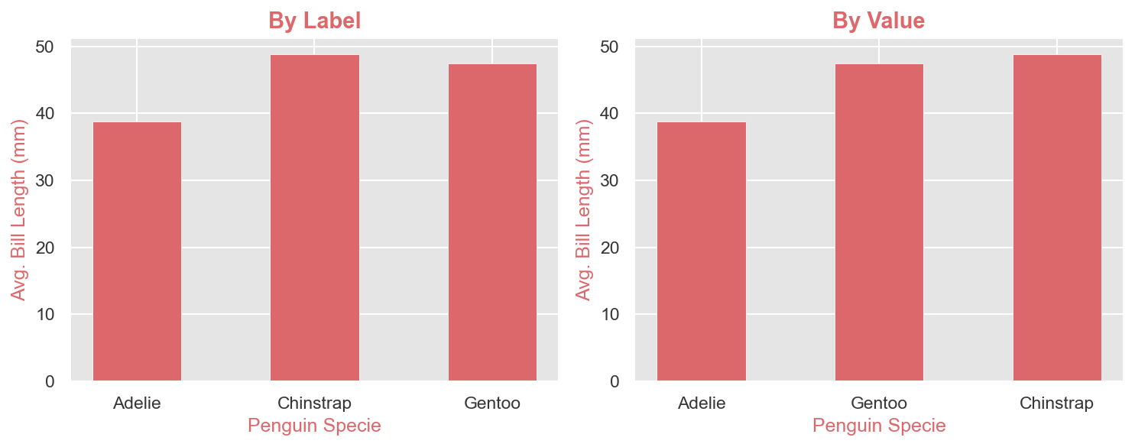
Bar Chart
One key, one value
1 categorical attribute
1 quantitative attribute
Task
Compare
Lookup values

Slide 10
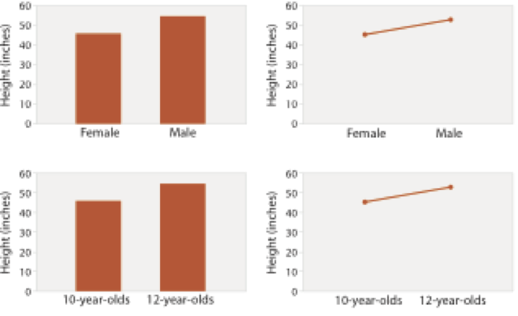
Bar Chart or Line Chart?
Depending on the type of key attribute
→ Bar charts if key is categorical
→ Line chart is key is ordered
Do not use line charts for categorical key attribute
Violates expressiveness principle
Implication of trend so strong that it overrides semantics
after [Bars and Lines: A Study of Graphic Communication. Zacks and Tversky. Memory and Cognition 27:6 (1999), 1073–1079.]

Slide 11
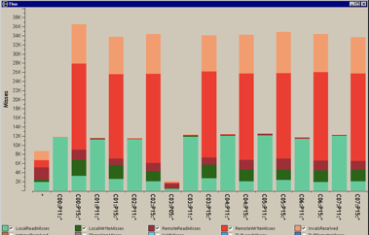
Stacked Bar Chart
Two keys, one value
2 categorical attributes
1 quantitative attribute
Task
Part-to-whole relationship
[Using Visualization to Understand the Behavior of Computer Systems. Bosch. Ph.D. thesis, Stanford Computer Science, 2001.]

Slide 12

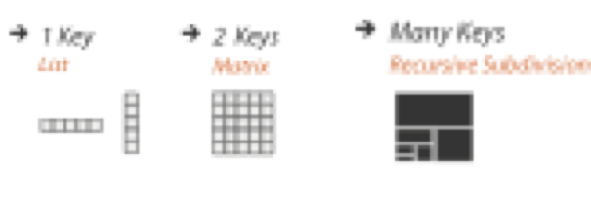
Heatmap
Two keys, one value
2 categorical attributes
1 quantitative attribute
Mark: area
Task
Find clusters, outliers

Slide 13
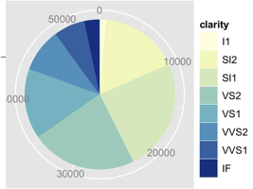
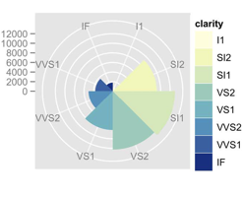
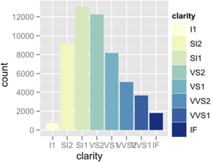
Pie Chart / Polar Area Chart
One key, one value
1 categorical attribute
1 quantitative attribute
Task
Part-to-whole judgements
Pie chart → Area marks with angle channel
Polar area chart → Area marks with length channel

Slide 14
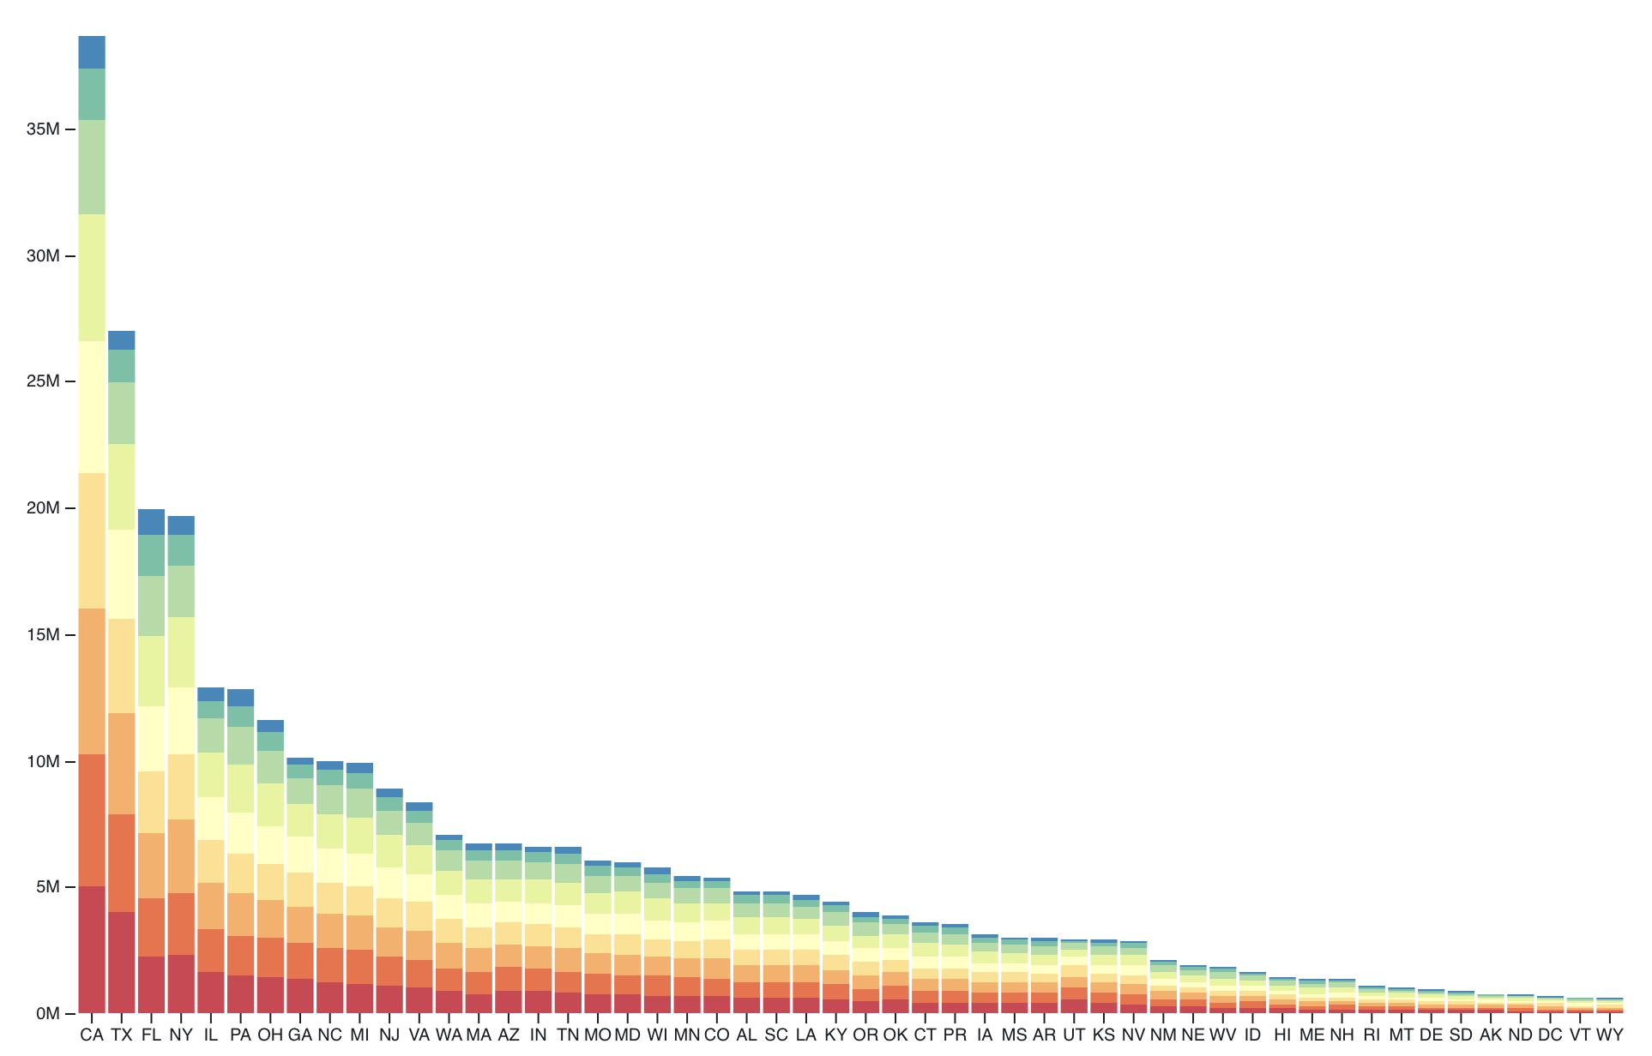
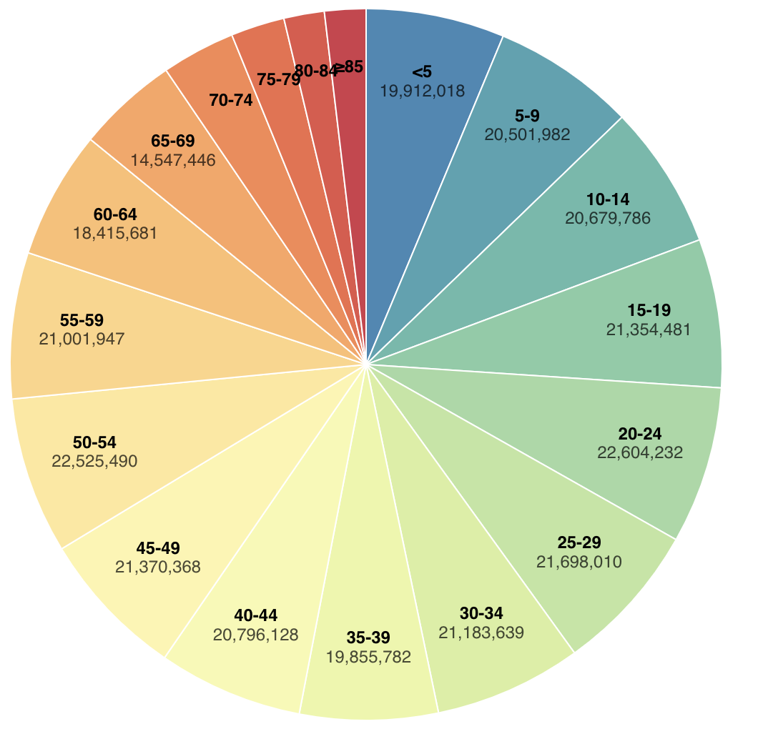
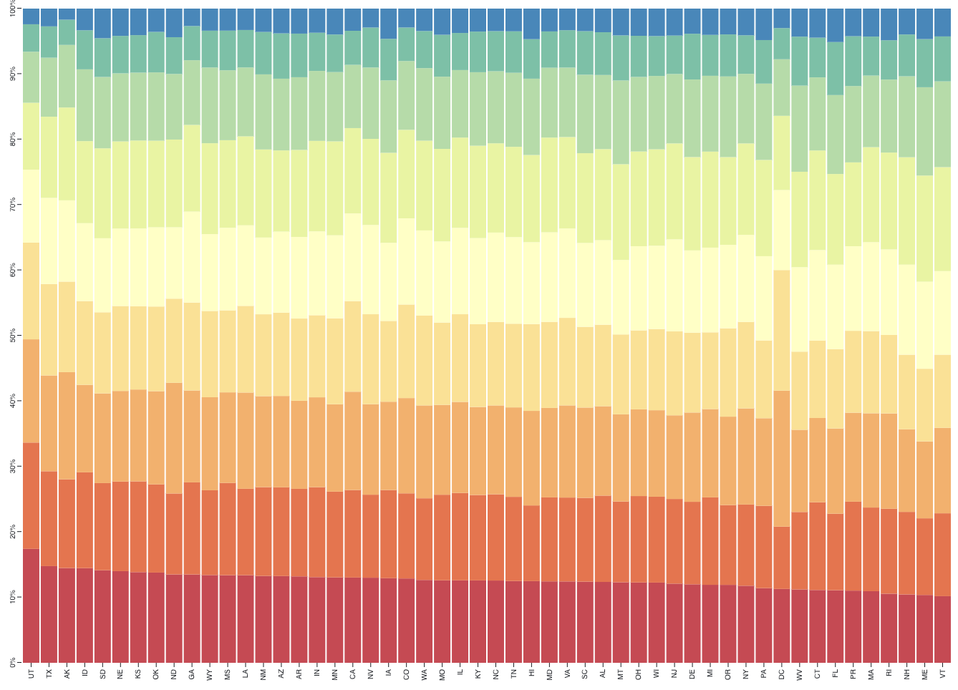
Normalized Stacked Bar Chart
Stacked bar chart, normalized to full vertical height
Single stacked bar is equivalent to a full pie.
Information density: normalized stacked bar only needs a narrow rectangle, but a pie needs a large circle.
https://observablehq.com/@d3/stacked-bar-chart
https://observablehq.com/@d3/stacked-normalized-horizontal-bar
https://observablehq.com/@d3/pie-chart

Slide 15
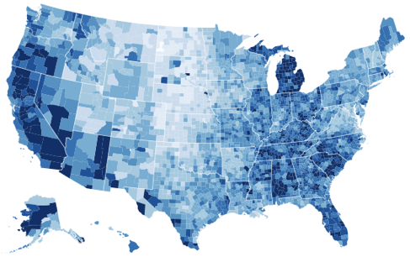
Choropleth Map
1 quantitative value per region
spatial geometry
1 quantitative attribute
Task
Understanding spatial relationships
Also called sequential segmented colormap, geographic heatmap
http://bl.ocks.org/mbostock/4060606

Slide 16
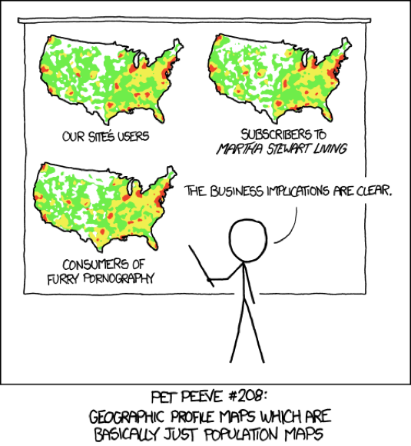
Population Map Trickiness!
B E W A R E !!! .
Absolute vs relative again
Population density vs per capita
Investigate with Ben Jones Tableau Public demo
http://public.tableau.com/profile/ben.jones#!/vizhome/PopVsFin/PopVsFin Are Maps of Financial Variable s just Population Maps?
Yes, unless you look at per capita (relative numbers)
[ https://xkcd.com/1138 ]

Slide 17
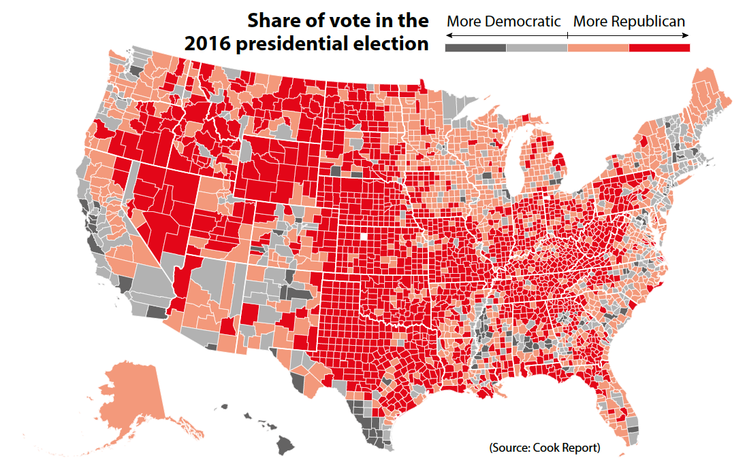
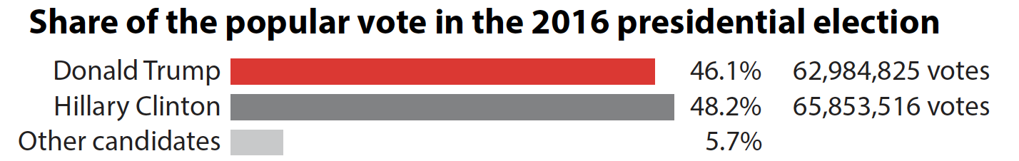
Population Map Trickiness!
Be careful in representing people (counts) as territories (area).
Aggregation can cause information loss.
Source: Alberto Cairo

Slide 18

Questions?
Ask away in the chat!

